Slide 1
Lecture 37:
Carbohydrates

Slide 2
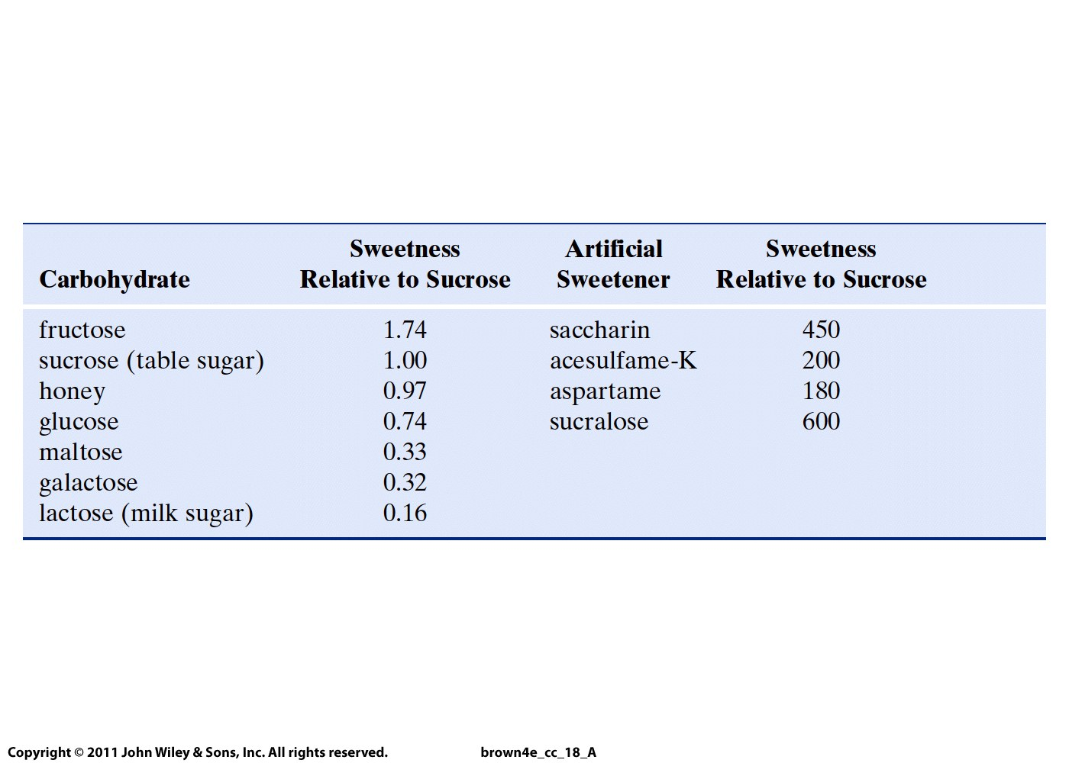

Slide 3
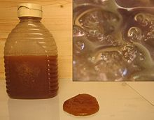
Honey is a mixture of glucose and fructose
Individual
glucose
grains in
the fructose
mixture
Partially crystallized honey

Slide 4
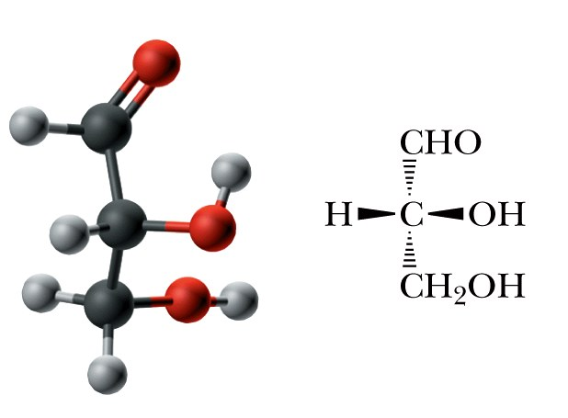
Carbohydrate: A polyhydroxyaldehyde, a polyhydroxyketone, or a substance that gives these compounds on hydrolysis.
Monosaccharide: A carbohydrate that cannot be hydrolyzed to a simpler carbohydrate.
  Monosaccharides have the general formula C_{n}H_{2n}O_{n}.
  The most common have from 3 to 9 carbons.
  Aldose: a monosaccharide containing an aldehyde group.
  Ketose: a monosaccharide containing a ketone group.

Slide 5
Carbohydrate: A polyhydroxyaldehyde, a polyhydroxyketone, or a substance that gives these compounds on hydrolysis.
Monosaccharide: A carbohydrate that cannot be hydrolyzed to a simpler carbohydrate.
  Monosaccharides have the general formula C_{n}H_{2n}O_{n}.
  The most common have from 3 to 9 carbons.
  Aldose: a monosaccharide containing an aldehyde group.
  Ketose: a monosaccharide containing a ketone group.

Slide 6
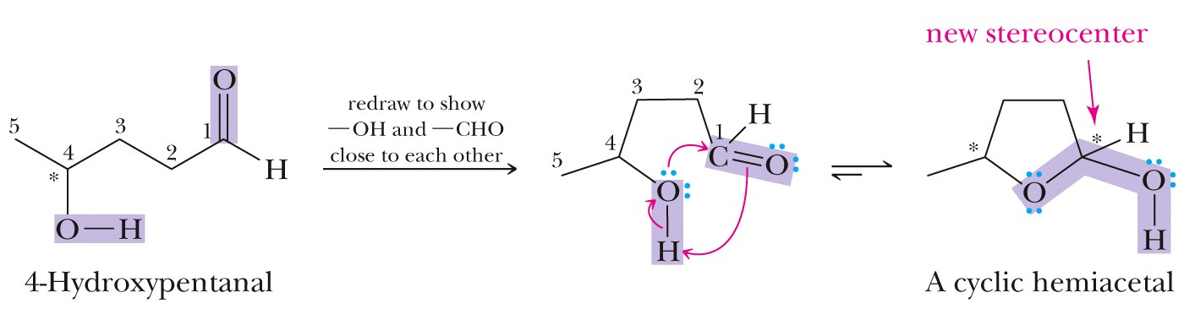
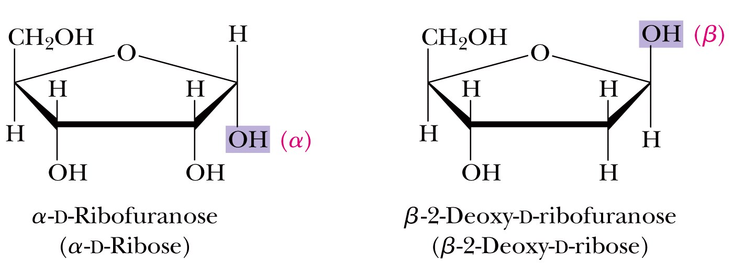

Slide 7
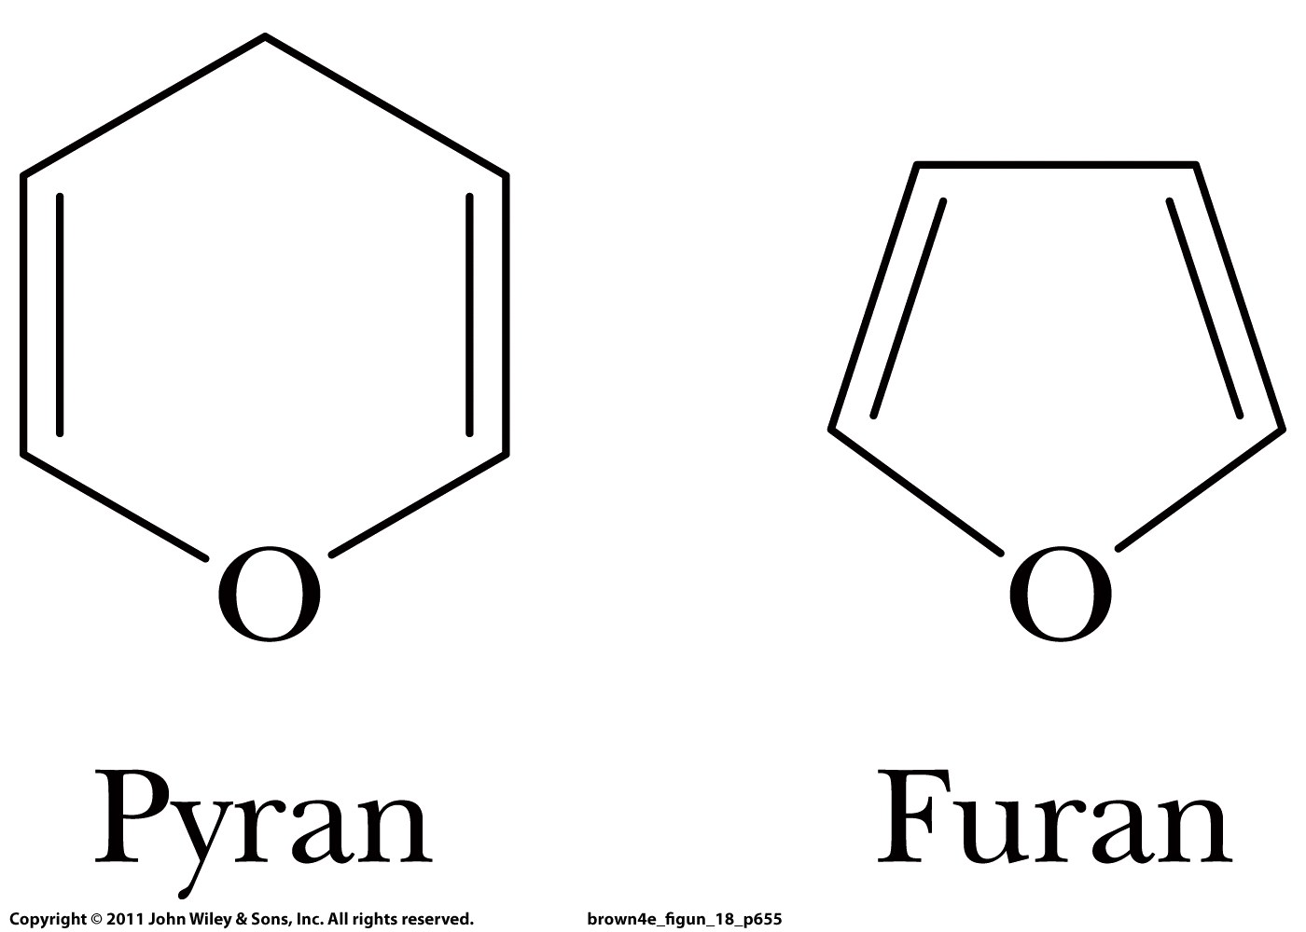

Slide 8
anomeric carbon
5
4
1
3
2

Slide 9
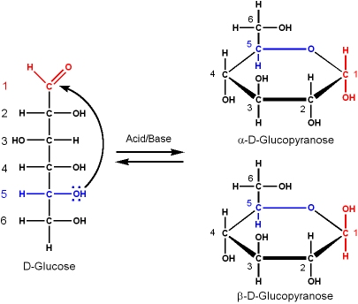
anomeric carbon
β-glucopyranose has the anomeric OH pointing to the same direction as CH₂OH

Slide 10
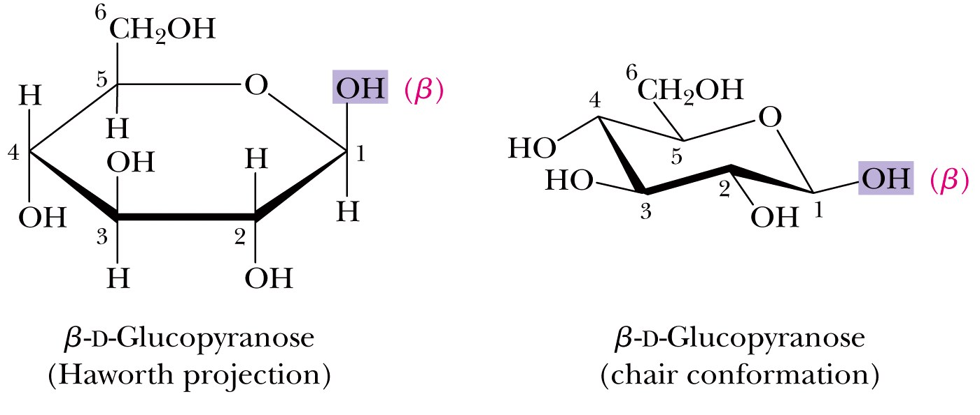
glucose
β-glucopyranose has the anomeric OH pointing to the same direction as CH₂OH

Slide 11
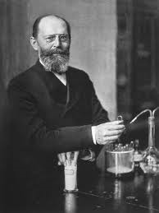
Emil Hermann Fischer (German)
Nobel Prize in 1902 in chemistry on
his research on purines and sugars

Slide 12
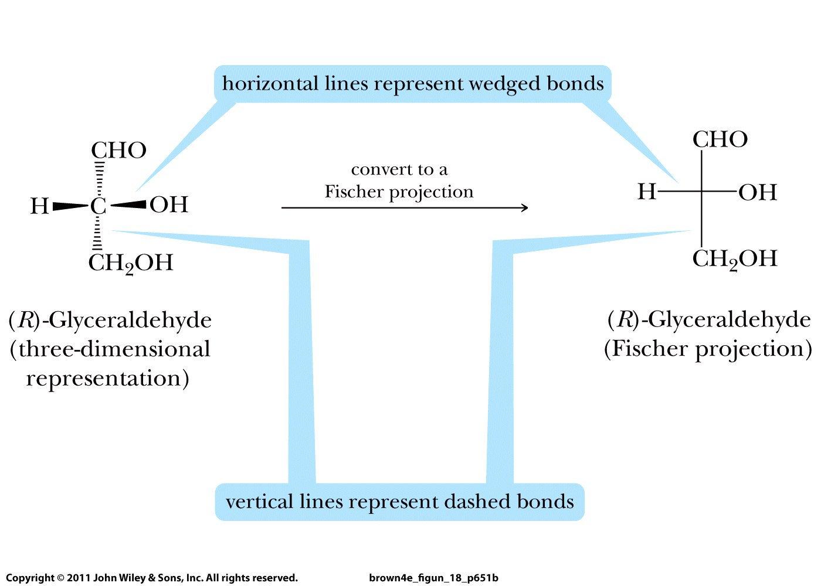
Fischer
projection
(R)-2,3-dihydroxypropanal

Slide 13
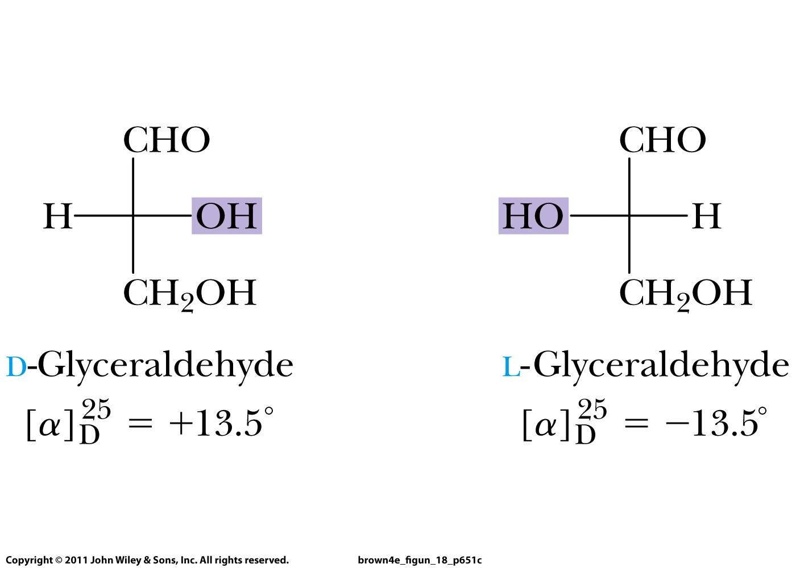
Fischer projections
(R)-
(S)-

Slide 14
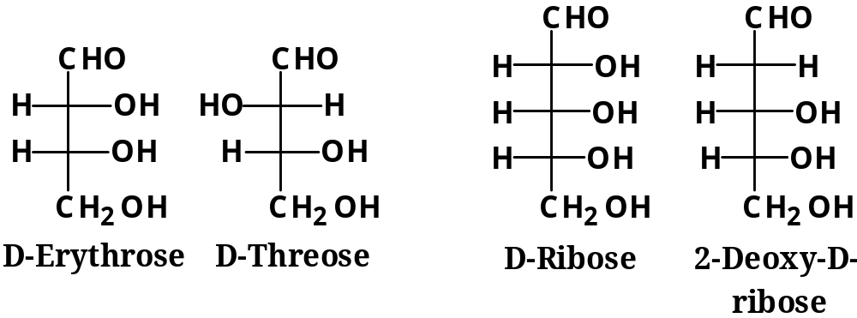
D-monosaccharides

Slide 16
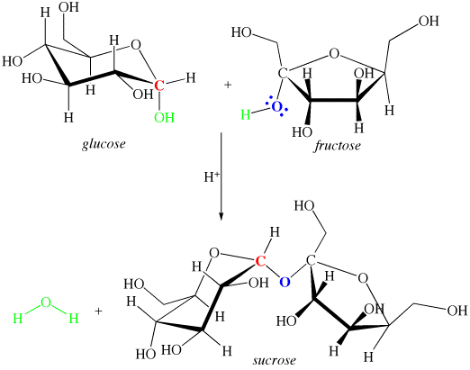
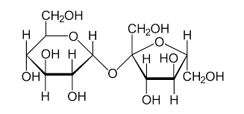
Formation of a glycosidic bond:
anomeric carbon
sucrose

Slide 17
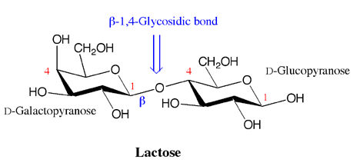
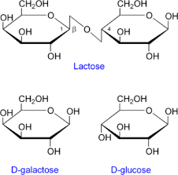
anomeric carbon
(milk sugar)

Slide 18
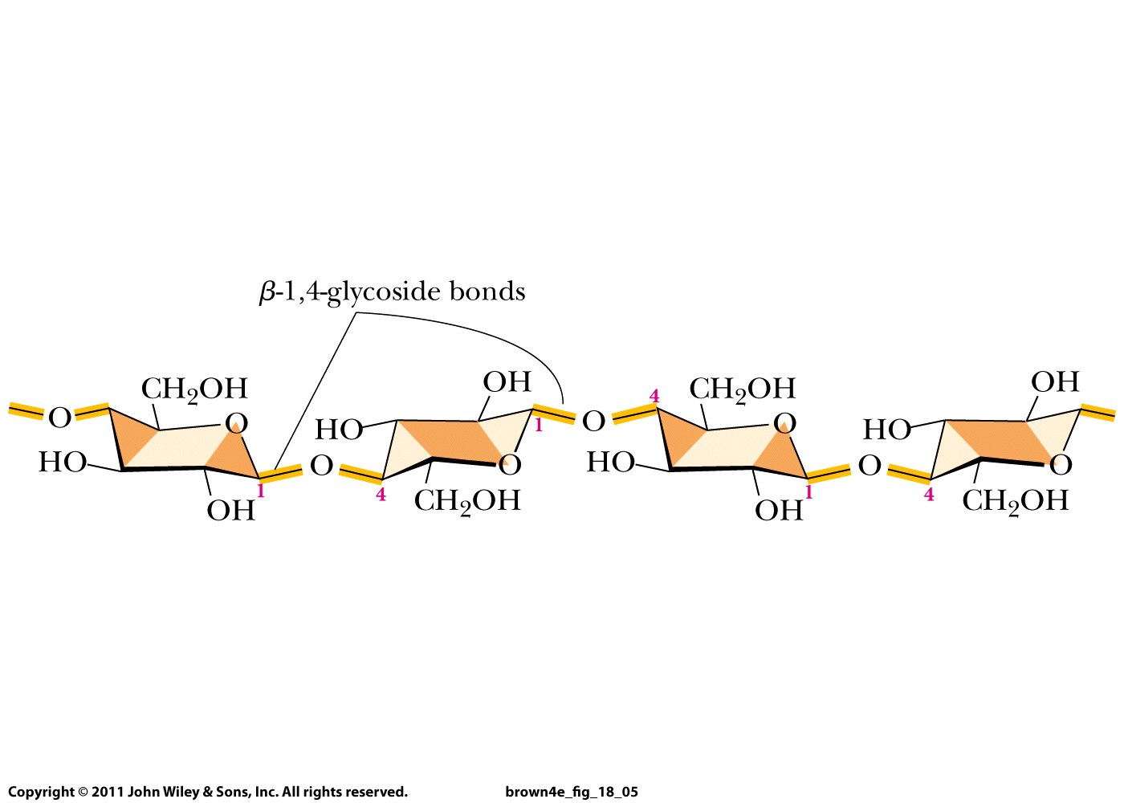
cellulose
Glucose molecules connected by β-1,4-glycosidic bonds

Slide 19
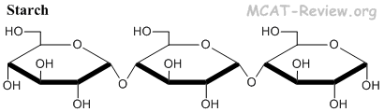
Glucose molecules connected by α-1,4-glycosidic bonds

